Slide 1

The grammar of graphics and tidyverse
Dr Adam Cribbs

Slide 2
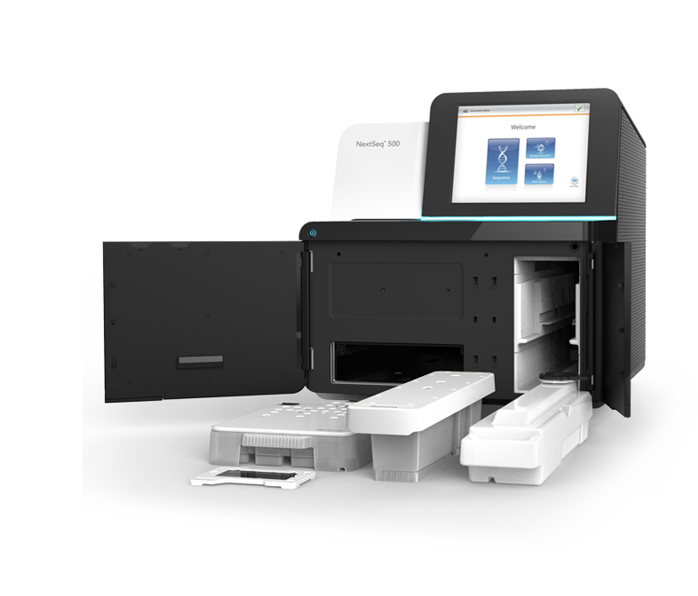
Agenda for this talk
01
What is Grammar og Graphics
02
The tidyverse
03
How to make publication quality plots in R
04
How to make publication quality figures

Slide 3
What is the grammar of graphics?
Visualizing multi-dimensional data is an art as well as science.
A layered framework called ”The Grammar of Graphics” can be leveraged to build useful graphs.
Sets of components that can be layered to make a compound figure

Slide 4
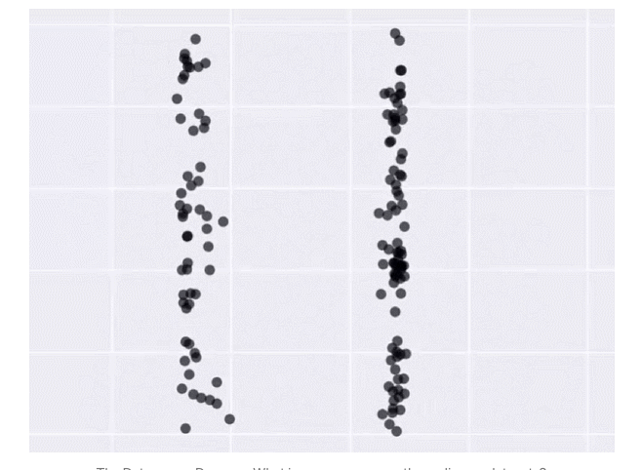
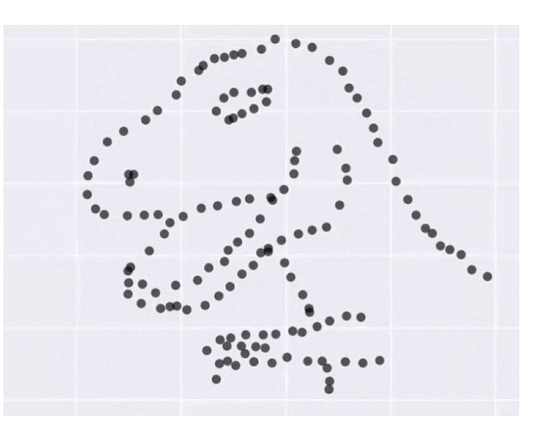
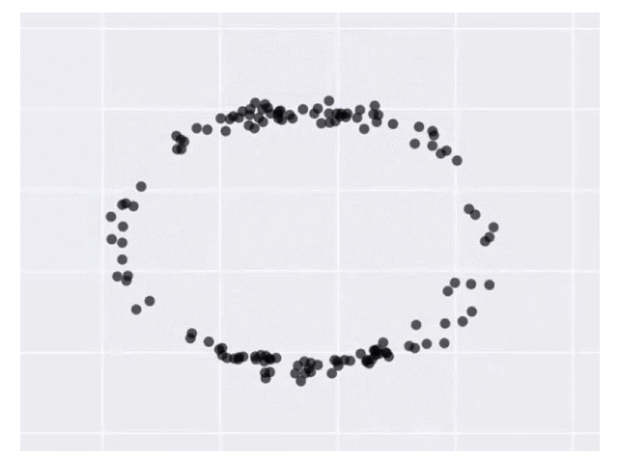
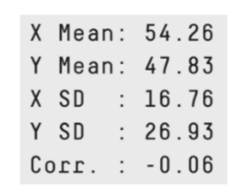
Data visualization as a story
What do these graphs all have in common?
Answer:
All the data is exactly the same

Slide 5
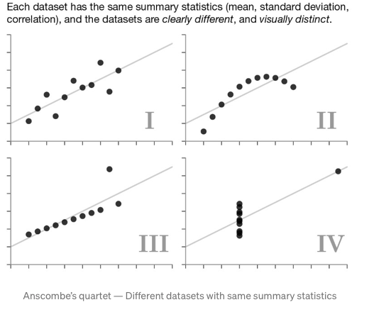
Anscombe’s quartet
Different datasets with the same summary statistics
“Do not trust your data blindly, and start modeling on your data”

Slide 6
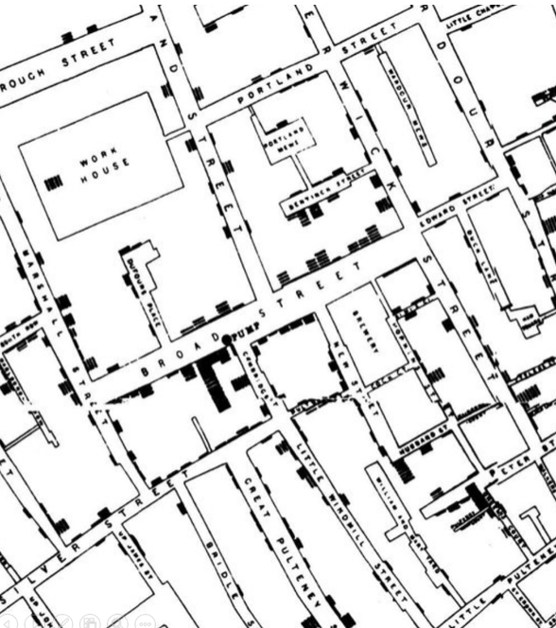
Famous examples of data visualisations
Broad street pump
John snow and cholera in London in 1854
Linking location with deaths from cholera
Led to realization that cholera is a waterborne illness
Removal of pump handle led to reduction in deaths

Slide 7
Understanding the grammar of graphics
Structural rules
Framework
Grammar is defined as a set of structural rules which helps define and establish components of language
It’s a framework that enables us to concisely describe components of any graphic
Syntax
Layered approach
The whole system and structure of a language usually consists of syntax and semantics
Instead of random trials and errors, it follows a layered approach by using defined components to build a vizualisation

Slide 8
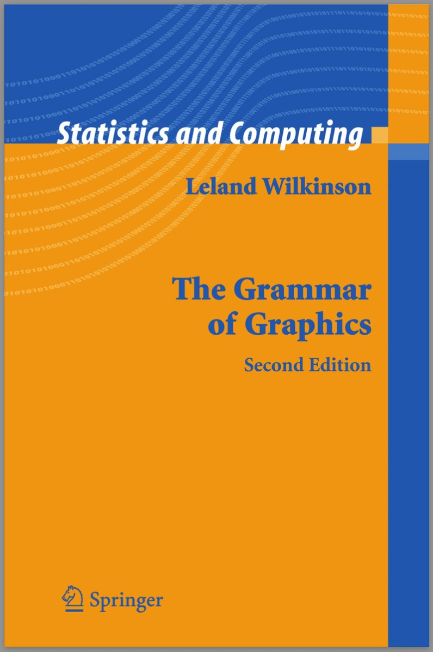

Understanding the grammar of graphics
Leyland Wilkinson
Inspired Hadley Wickham’s ggplot2
Layered grammar of graphics framework

Slide 9
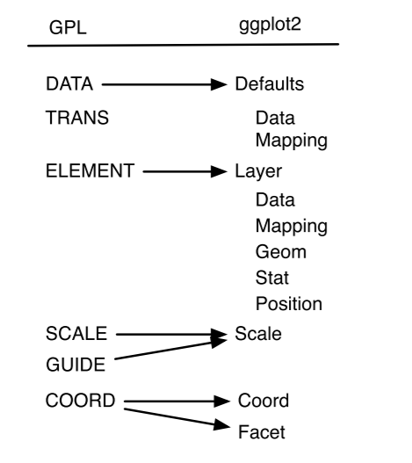
Mappings between grammar of graphics and layered grammar of graphics
Hadley’s layered grammar of graphics uses several layered components to describe any graphic or visualization. Most notably, it has some variations from the original grammar of graphics

Slide 10
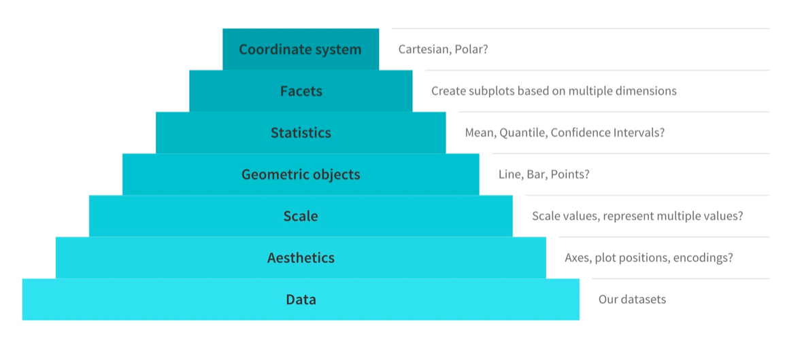
Major components of grammar of graphics

Slide 11
Major components of grammar of graphics
1. Data: Always start with the data, identify the dimensions you want to visualize.
2. Aesthetics: Confirm the axes based on the data dimensions, positions of various data points in the plot. Also check if any form of encoding is needed including size, shape, color and so on which are useful for plotting multiple data dimensions.
3. Scale: Do we need to scale the potential values, use a specific scale to represent multiple values or a range?
4. Geometric objects: These are popularly known as ‘geoms’. This would cover the way we would depict the data points on the visualization. Should it be points, bars, lines and so on?
5. Statistics: Do we need to show some statistical measures in the visualization like measures of central tendency, spread, confidence intervals?
6. Facets: Do we need to create subplots based on specific data dimensions?
7. Coordinate system: What kind of a coordinate system should the visualization be based on — should it be cartesian or polar?

Slide 12
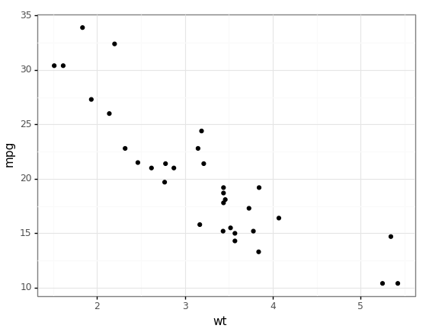
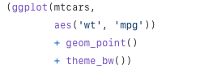
Always start with the data

Slide 13
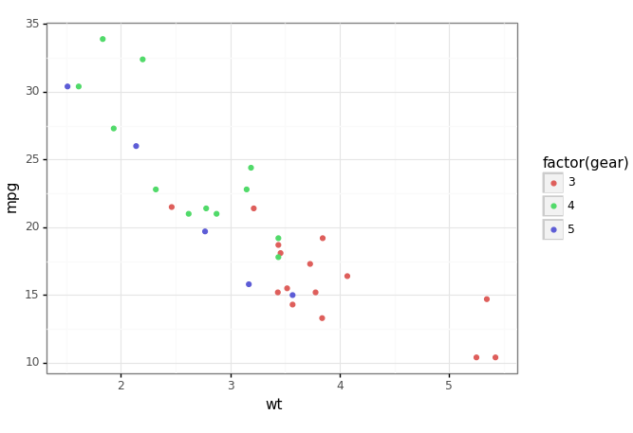
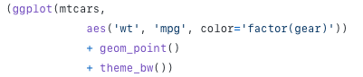
Visualise in three-dimensions

Slide 14
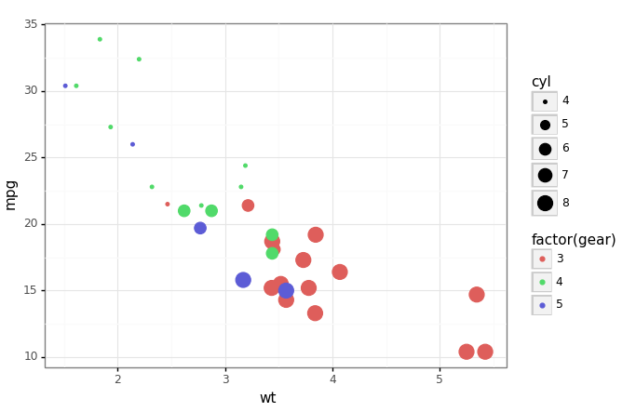
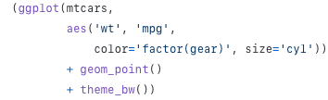
Visualise in four-dimensions

Slide 15
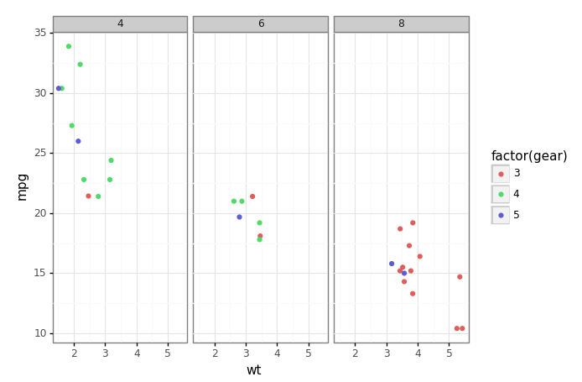
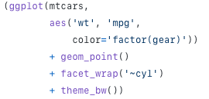
Facet wrap

Slide 16
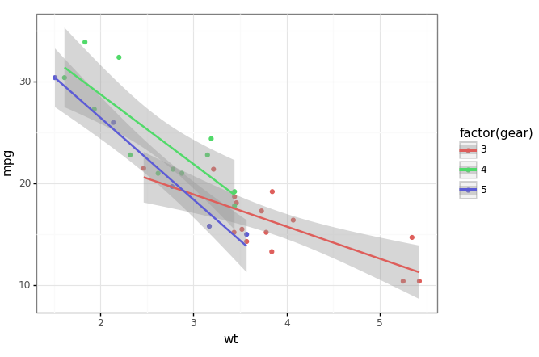
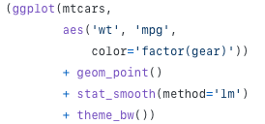
Visualize statistics and dimensions

Slide 17
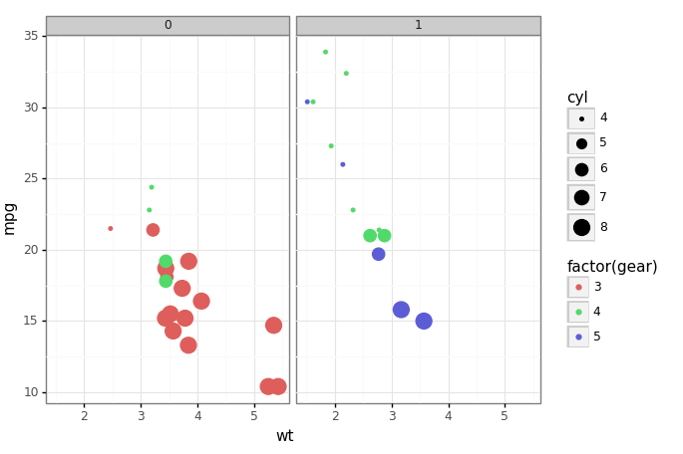
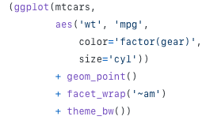
Visualize five dimensions

Slide 18
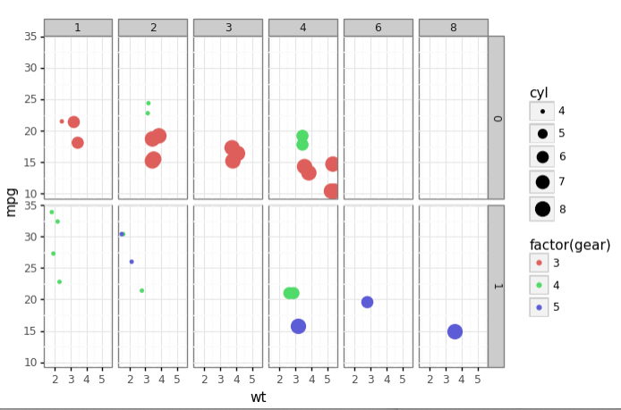
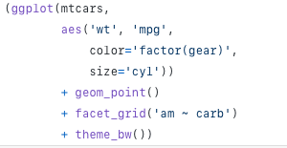
Visualize six dimensions

Slide 19
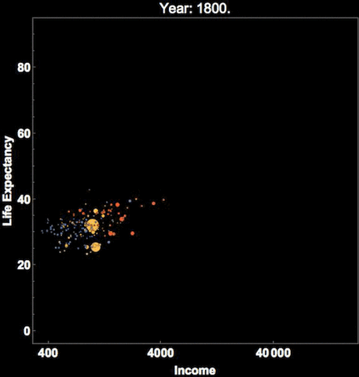
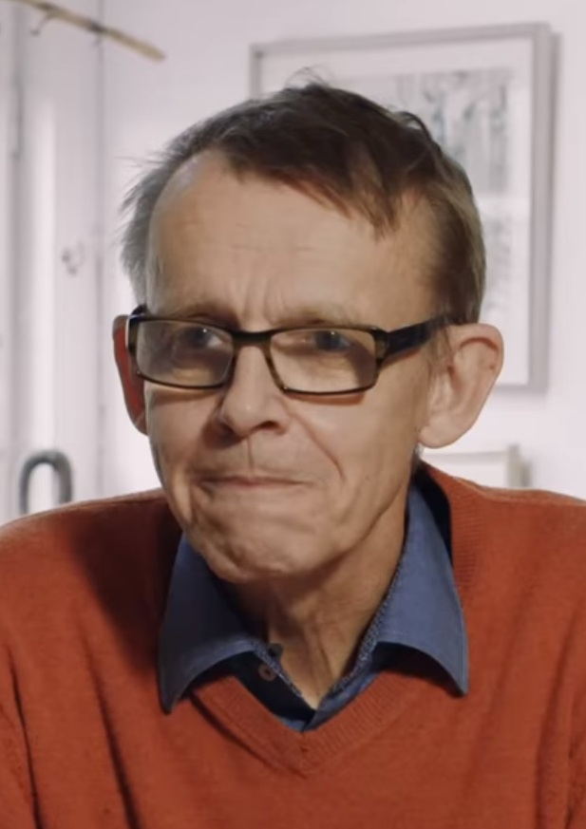
More dimensions?
Hans Rosling
Add more facets and a time component

Slide 20
The tidyverse

Slide 21
A vector in R
1D data structure of fixed type
scores
1
0.8
mean(scores)
sd(scores)
1.2
2
3.3
3
1.8
4
2.7
5

Slide 22
A list in R
results
A collection of vectors
“ratios”
“counts”
results$counts
mean(results$counts)
1
2
1
0.8
1
100
1.2
300
2
2
3.3
200
3
3
1.8
4
2.7
5

Slide 23
A DataFrame in R
A collection of vectors with the same lengths
Concept of rows
all.results
all.results$mon
mean(all.results$mon)
“mon”
“tue”
“wed”
“pass”
1
2
3
4
1
0.8
0.9
0.8
T
0.6
0.7
0.5
F
2
0.2
0.3
0.3
F
3
0.8
0.8
0.9
T
4
0.6
1.0
0.9
T
5

Slide 24
A Tibble in R
A collection of vectors with the same lengths
Concept of rows
all.results
all.results$mon
mean(all.results$mon)
“mon”
“tue”
“wed”
“pass”
1
2
3
4
1
0.8
0.9
0.8
T
0.6
0.7
0.5
F
2
0.2
0.3
0.3
F
3
0.8
0.8
0.9
T
4
0.6
1.0
0.9
T
5

Slide 25
A Tibble is a nicer dataframe
> head(as.data.frame(data))
Probe Chromosome Start End Probe Strand Feature
1 AL645608.2 1 911435 914948 + AL645608.2
2 LINC02593 1 916865 921016 - LINC02593
3 SAMD11 1 923928 944581 + SAMD11
4 TMEM51-AS1 1 15111815 15153618 - TMEM51-AS1
5 TMEM51 1 15152532 15220478 + TMEM51
6 FHAD1 1 15247272 15400283 + FHAD1
Description
1 novel transcript
2 long intergenic non-protein coding RNA 2593 [Source:HGNC Symbol;Acc:HGNC:53933]
3 sterile alpha motif domain containing 11 [Source:HGNC Symbol;Acc:HGNC:28706]
4 TMEM51 antisense RNA 1 [Source:HGNC Symbol;Acc:HGNC:26301]
5 transmembrane protein 51 [Source:HGNC Symbol;Acc:HGNC:25488]
6 forkhead associated phosphopeptide binding domain 1 [Source:HGNC Symbol;Acc:HGN

Slide 26
A Tibble is a nicer dataframe
> head(as_tibble(data))
# A tibble: 6 x 12
Probe Chromosome Start End `Probe Strand` Feature ID Description
<chr> <dbl> <dbl> <dbl> <chr> <chr> <chr> <chr>
1 AL64~ 1 9.11e5 9.15e5 + AL6456~ ENSG~ novel tran~
2 LINC~ 1 9.17e5 9.21e5 - LINC02~ ENSG~ long inter~
3 SAMD~ 1 9.24e5 9.45e5 + SAMD11 ENSG~ sterile al~
4 TMEM~ 1 1.51e7 1.52e7 - TMEM51~ ENSG~ TMEM51 ant~
5 TMEM~ 1 1.52e7 1.52e7 + TMEM51 ENSG~ transmembr~
6 FHAD1 1 1.52e7 1.54e7 + FHAD1 ENSG~ forkhead a~
# ... with 4 more variables: `Feature Strand` <chr>, Type <chr>, `Feature
# Orientation` <chr>, Distance <dbl>

Slide 27


Tidyverse
A collection of R packages
Aims to fix many of Rs core structural problems
Common design and data philosophy
Packages designed to work together and integrate seamlessly with other parts of R
https://www.tidyverse.org/
Hadley Wickham

Slide 28


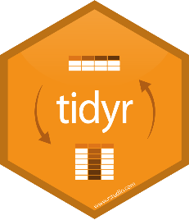

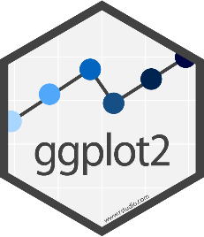
Tidyverse packages
Tibble - data storage
ReadR - reading data from files
TidyR - Model data correctly
DplyR - Manipulate and filter data
ggplot2 - Draw figures and graphs

Slide 29
Tidyverse installation and loading
install.packages("tidyverse")
library(tidyverse)
-- Attaching packages ---------- tidyverse 1.3.0 –
v ggplot2 3.3.2 v purrr 0.3.4
v tibble 3.0.2 v dplyr 1.0.0
v tidyr 1.1.0 v stringr 1.4.0
v readr 1.3.1 v forcats 0.5.0
-- Conflicts ------------- tidyverse_conflicts() –
x dplyr::filter() masks stats::filter()
x dplyr::lag() masks stats::lag()

Slide 30
Reading and writing with readr
Provides functions to read from text files into tibbles or write from tibbles to text files
read_delim("file.txt") -> data
read_csv("file.csv") -> data
read_tsv("file.tsv") -> data
write_csv(data,"file.csv")
write_tsv(data,"file.csv")

Slide 31
Specifying file paths
You can use full file paths, but it's a pain
Just set the 'working directory' and then just provide a file name
setwd(path)
Session > Set Working Directory > Choose Directory
Use [Tab] to fill in file paths in the editor
read_tsv("") – put the cursor in the quotes and press tab
read_csv("O:/Training/R_tidyverse_intro_data/neutrophils.csv")

Slide 32
Reading files with readr
> read_delim("trumpton.txt") -> trumpton
Rows: 7 Columns: 5
-- Column specification ------------------------------
Delimiter: "\t"
chr (2): LastName, FirstName
dbl (3): Age, Weight, Height
> trumpton
# A tibble: 7 x 5
LastName FirstName Age Weight Height
<chr> <chr> <dbl> <dbl> <dbl>
1 Hugh Chris 26 90 175
2 Pew Adam 32 102 183
3 Barney Daniel 18 88 168
4 McGrew Chris 48 97 155
5 Cuthbert Carl 28 91 188
6 Dibble Liam 35 94 145
7 Grub Doug 31 89 164

Slide 33
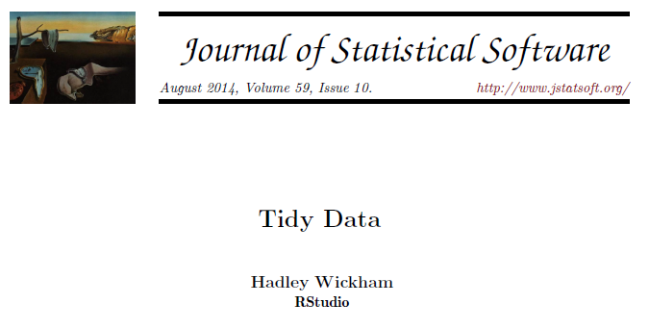
The ‘Tidy’ data format
Tibbles give you a 2D data structure where each column must be of a fixed data type
Often data can be put into this sort of structure in more than one way
Is there a right / wrong way to structure your data?

Slide 34
Long vs wide data formats
Consider a simple experiment:
Two genes tested (ABC1 and DEF1)
Two conditions (WT and KO)
Three replicates for each condition

Slide 35
wide data formats
Gene | WT_1 | WT_2 | WT_3 | KO_1 | KO_2 | KO_3
ABC1 | 8.86 | 4.18 | 8.90 | 4.00 | 14.52 | 13.39
DEF1 | 29.60 | 41.22 | 36.15 | 11.18 | 16.68 | 1.64
Compact
Easy to read
Shows linkage for genes
No explicit genotype or replicate
Values spread out over multiple rows and columns
Not extensible to more metadata

Slide 36
Long data formats
Gene | Genotype | Replicate | Value
ABC1 | WT | 1 | 8.86
ABC1 | WT | 2 | 4.18
ABC1 | WT | 3 | 8.90
ABC1 | KO | 1 | 4.00
ABC1 | KO | 2 | 14.52
ABC1 | KO | 3 | 13.39
DEF1 | WT | 1 | 29.60
DEF1 | WT | 2 | 41.22
DEF1 | WT | 3 | 36.15
DEF1 | KO | 1 | 11.18
DEF1 | KO | 2 | 16.68
DEF1 | KO | 3 | 1.64
More verbose (repeated values)
Explicit genotype and replicate
All values in a single column
Extensible to more metadata

Slide 37
Filtering and subsetting
Tidyverse (specifically dplyr) comes with functions to manipulate your data.
All functions take a tibble as their first argument
All functions return a modified tibble
Selecting columns
Logical subsetting

Slide 38
Filtering and subsetting
> trumpton
# A tibble: 7 x 5
LastName FirstName Age Weight Height
<chr> <chr> <dbl> <dbl> <dbl>
1 Hugh Chris 26 90 175
2 Pew Adam 32 102 183
3 Barney Daniel 18 88 168
4 McGrew Chris 48 97 155
5 Cuthbert Carl 28 91 188
6 Dibble Liam 35 94 145
7 Grub Doug 31 89 164

Slide 39
Filtering and subsetting
Select to pick columns
> select(trumpton,FirstName,LastName, Weight)
# A tibble: 7 x 3
FirstName LastName Weight
<chr> <chr> <dbl>
1 Chris Hugh 90
2 Adam Pew 102
3 Daniel Barney 88
4 Chris McGrew 97
5 Carl Cuthbert 91
6 Liam Dibble 94
7 Doug Grub 89

Slide 40
Filtering and subsetting
Use positions instead of names
> select(trumpton, 2,4)
# A tibble: 7 x 2
FirstName Weight
<chr> <dbl>
1 Chris 90
2 Adam 102
3 Daniel 88
4 Chris 97
5 Carl 91
6 Liam 94
7 Doug 89

Slide 41
Filtering and subsetting
Using negative selections
> select(trumpton, -LastName)
# A tibble: 7 x 4
FirstName Age Weight Height
<chr> <dbl> <dbl> <dbl>
1 Chris 26 90 175
2 Adam 32 102 183
3 Daniel 18 88 168
4 Chris 48 97 155
5 Carl 28 91 188
6 Liam 35 94 145
7 Doug 31 89 164

Slide 42
Filtering and subsetting
Functional selections using filter
> filter(trumpton, Height>=170)
# A tibble: 3 x 5
LastName FirstName Age Weight Height
<chr> <chr> <dbl> <dbl> <dbl>
1 Hugh Chris 26 90 175
2 Pew Adam 32 102 183
3 Cuthbert Carl 28 91 188

Slide 43
Filtering and subsetting
Types of filer
Greater than
weight > 20
weight >= 30
Less than
height < 170
height <= 180
Equal to (or not)
value == 5
name == "simon"
name != "simon"
> filter(trumpton, FirstName == "Chris")
# A tibble: 2 x 5
LastName FirstName Age Weight Height
<chr> <chr> <dbl> <dbl> <dbl>
1 Hugh Chris 26 90 175
2 McGrew Chris 48 97 155

Slide 44
Filtering and subsetting
You can transform data in a filter
Select rows where the difference (in either direction) is more than 5
> filter(transform.data, difference > 5)
# A tibble: 1 x 3
WT KO difference
<dbl> <dbl> <dbl>
1 -8.69 -2.38 6.31
> filter(transform.data, difference < -5)
# A tibble: 1 x 3
WT KO difference
<dbl> <dbl> <dbl>
1 -1.93 -10.0 -8.10
> transform.data
# A tibble: 10 x 3
WT KO difference
<dbl> <dbl> <dbl>
1 -5.11 -3.29 1.81
2 1.12 -1.85 -2.97
3 -3.99 -3.77 0.222
4 -4.18 -2.46 1.72
5 -1.93 -10.0 -8.10
6 -8.69 -2.38 6.31
7 -0.670 2.73 3.40
8 -1.15 -2.59 -1.43
9 -1.98 1.83 3.80
10 -1.06 0.372 1.43
> filter(transform.data, abs(difference) > 5)
# A tibble: 2 x 3
WT KO difference
<dbl> <dbl> <dbl>
1 -1.93 -10.0 -8.10
2 -8.69 -2.38 6.31

Slide 45
Combining multiple operations
The long winded way…
Three separate operations with two intermediate variables
Works, but is ugly!
> filter(trumpton, Height >= 170) -> answer1
> filter(answer1, FirstName == "Chris") -> answer2
> select(answer2, Age, Weight)
# A tibble: 1 x 2
Age Weight
<dbl> <dbl>
1 26 90

Slide 46
Pipes are extremely useful
All tidyverse functions take a tibble as their first argument
All tidyverse functions return a tibble
You can therefore chain operations together, passing the output of one function as the first input to another
Data → Filter 1 → Filter 2 → Selection

Slide 47
The pipe operator: %>%
Takes the data on its left and makes it the first argument to a function on its right.
> select(trumpton,-LastName)
# A tibble: 7 x 4
FirstName Age Weight Height
<chr> <dbl> <dbl> <dbl>
1 Chris 26 90 175
2 Adam 32 102 183
3 Daniel 18 88 168
4 Chris 48 97 155
5 Carl 28 91 188
6 Liam 35 94 145
7 Doug 31 89 164
> trumpton %>% select(-LastName)
# A tibble: 7 x 4
FirstName Age Weight Height
<chr> <dbl> <dbl> <dbl>
1 Chris 26 90 175
2 Adam 32 102 183
3 Daniel 18 88 168
4 Chris 48 97 155
5 Carl 28 91 188
6 Liam 35 94 145
7 Doug 31 89 164

Slide 48
Combining multiple operations with pipes
Give the age and weight for people who are taller than 170cm and called Chris
trumpton %>% filter(Height>=170) %>% filter(FirstName=="Chris") %>% select(Age,Weight)
trumpton
filter(Height>=170)
filter(FirstName=="Chris")
select(Age,Weight)
# A tibble: 1 x 2
Age Weight
<dbl> <dbl>
1 26 90
%>%
%>%
%>%

Slide 50

Naming and storing your data
Organisation is key!
Electronic lab notebook – keep a record of the file directory!
Naming files is important
Use new clavical drives to store your raw data and do not touch original files! If you manipulate data save it elsewhere (processed directory)

Slide 51
How to name a file
Never use spaces
Easier to find files. If you use any computer programs spaces can create issues
Easier to find files. If you use any computer programs spaces can create issues
RiskManagement | Risk_management Risk management
Keep your file names short
UdosCrazyExperiment | Udo_asked_me_to_do_this_crazy_experiment

Slide 52
How to name a file
Dates back to front
Easier to find files. If you use any computer programs spaces can create issues
Never use * : \ / < > | " ? [ ] ; = + & £ $
20190522_MMTimecourse | 22052019_MMTimecourse 5stMay2019_MMTimecourse
Use two digits for numbers
File01 File02 File03 | File1 File10 File11 File2

Slide 53
File formats for figures
Saving an image in the right format is key for figure generation
Pictures from Microscopes should be saved as high quality TIFF files and not jpeg, png (files that are compressed)
Plots should be saved as vector images – I find eps format best
To understand the difference between the two you need to understand how images are processed in a computer

Slide 54
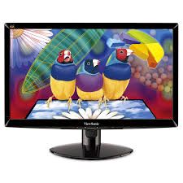
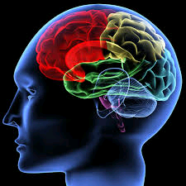
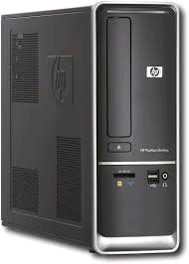
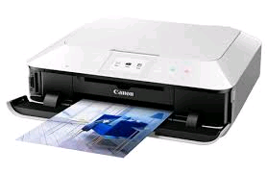
Computer graphics
Concepts
Ideas
Representation
Display
Notes:
How to get from concepts and ideas to a visualization via computer

Slide 55
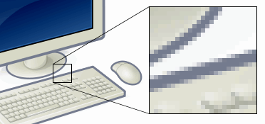
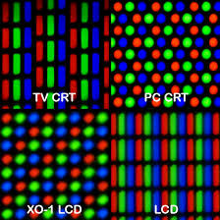
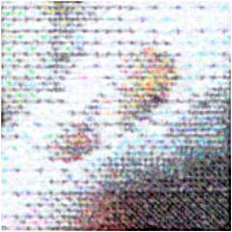
Pixel images
Screen
Image is constructed:
per pixel
line by line
in groups of lines
http://en.wikipedia.org/
Inkjet Printer
Notes:
Everything is about pixels, both on screen and in print. We will not talk about dynamics of images (refresh rate, frame rate, etc)

Slide 56

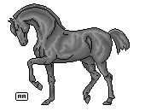

Matrix to images
Black and White
00000000000000000000
11100011100101010101
…
…
1 bit per pixel
800kb (~ 1024 * 768)
256 grades of grey
8 bits per pixel
008 112 115 004 000
012 200 256 000 000
…
6.3 Mb (~ 8 * 800kb )
16M colours
24 bits per pixel
008 112 115 004 000
012 200 256 000 000
…
008 112 115 004 000
012 200 256 000 000
…
19Mb (~3 * 6.3Mb)
008 112 115 004 000
012 200 256 000 000
…

Slide 57
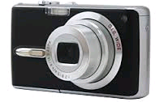
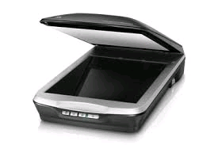
Two types of graphics
Bitmap graphics
Vector graphics
Image is stored as matrix
Image is stored as instructions
line in red from x1,y1 to x2,y2
circle in blue at x, y, radius r
Inkscape, Coreldraw, Illustrator, …
svg, ps/eps, wmf, …
Gimp, Photoshop, Paintshop, …
png, jpg, tiff, bmp, …
Plotting
Tracing

Slide 58
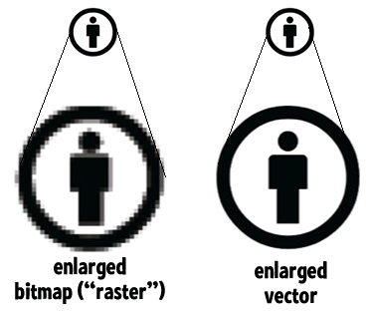
Bitmap vs vector

Slide 59
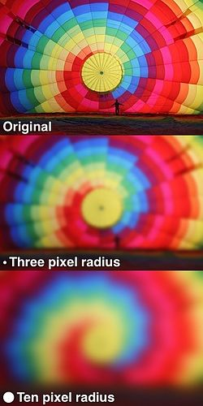
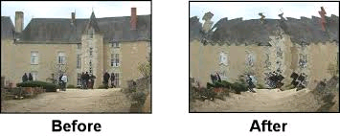
Bitmap manipulation
Colour manipulations
Effects
…
Wave effects
Gaussian blur
Pixel(x,y) = f(Pixel(x-1, y-1), Pixel(x-1,y), …)

Slide 60
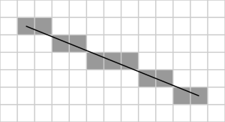
From vector to bitmap
def line(x0, x1, y0, y1):
deltax = x1 - x0
deltay = y1 - y0
error = 0
deltaerr = abs (deltay / deltax)
if y0 > y1:
increment = 1
else
increment = -1
int y = y0
for x in range(x0, x1):
plot(x, y)
error = error + deltaerr
while error ≥ 0.5:
plot(x, y)
if y1 != y0:
y += increment
error -= 1.0
Bresenham’s Line Algorithm
without
with
To improve:
anti-alias
http://en.wikipedia.org/wiki/Bresenham%27s_line_algorithm
https://courses.engr.illinois.edu/ece390/archive/archive-f2000/mp/mp4/anti.html
Notes:
Fortunately, we don’t have to do this ourselves

Slide 61

Vectors build images
Write script to output vector
graphics instructions
View, Display, Print in 3rd party
tools
Display
Browser
SVG, EPS, WMF, …
SVG Example
<svg>
<rect x="10" y="10" height="100" width="100" style="stroke:#ff0000; fill: #0000ff"/>
</svg>
WWW Standard
Shapes: circles, ellipses, lines, rectangles, …
Text
Paths
Clipping/Masking
Colours
Notes:
Method 1: Use python to output plotting instructions, then use a 3rd party to to display

Slide 62
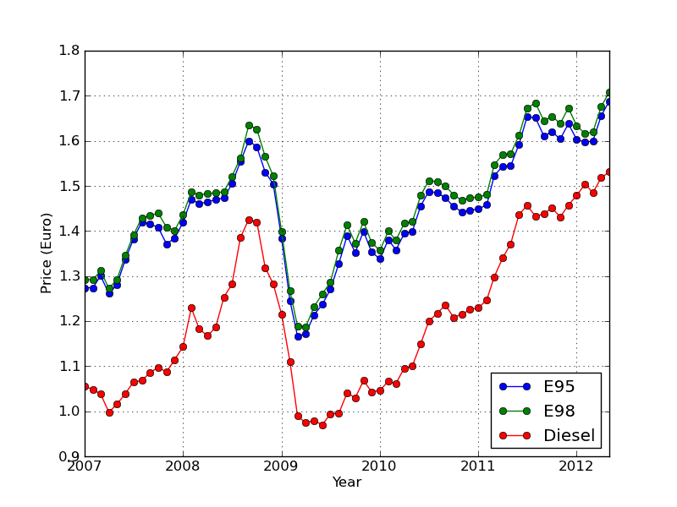
Can be tedious
write dot
write line
write circle
write line
Check layout!
write text

Slide 63
Graphics packages
Graphics packages build plots from representations of the parts of the image
User
write to file as
png, …
svg, …
display on screen
Plot line data
Add tick marks
Add labels
Scene
Render

Slide 64
Making figures with the correct program
Always make figures with vector graphics editor
Illustrator, inkscape, GIMP
NEVER EVER USE POWERPOINT!
Not a vector graphics editor
Cant crate high quality images
Compression issues

Slide 65
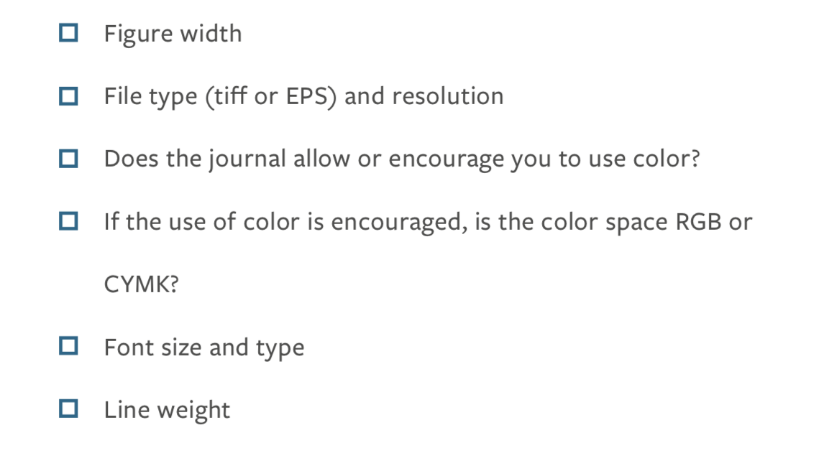
Consult journal guidelines
Different journals have different guidelines for figures
Adhere to them
CMYK is a subtractive color model
RGB is a additive colour model
Main difference is RGB used for screen while CMYK is used for print
https://www.aje.com/dist/docs/Guide-Creating-Effective-Scientific-Figures-for-Publication.pdf

Slide 66
Consistency
General guidelines
Single column 85mm
1.5 column 135mm
Double column 175mm
Font: 8 point Arial
Avoid bolding or italics

